Slide 1


Mobile Bookings and the Future of Expedia Inc.
Authored by: GG Plotters

Slide 2
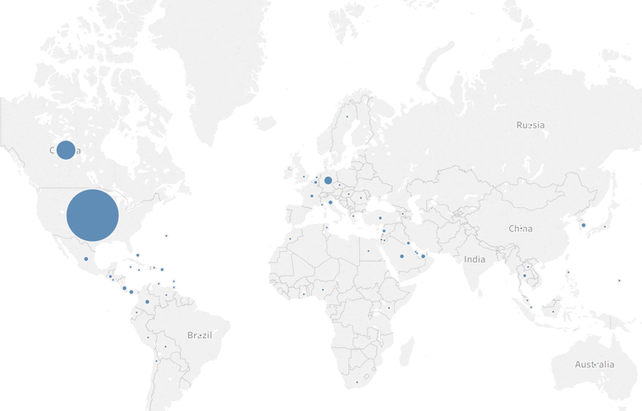
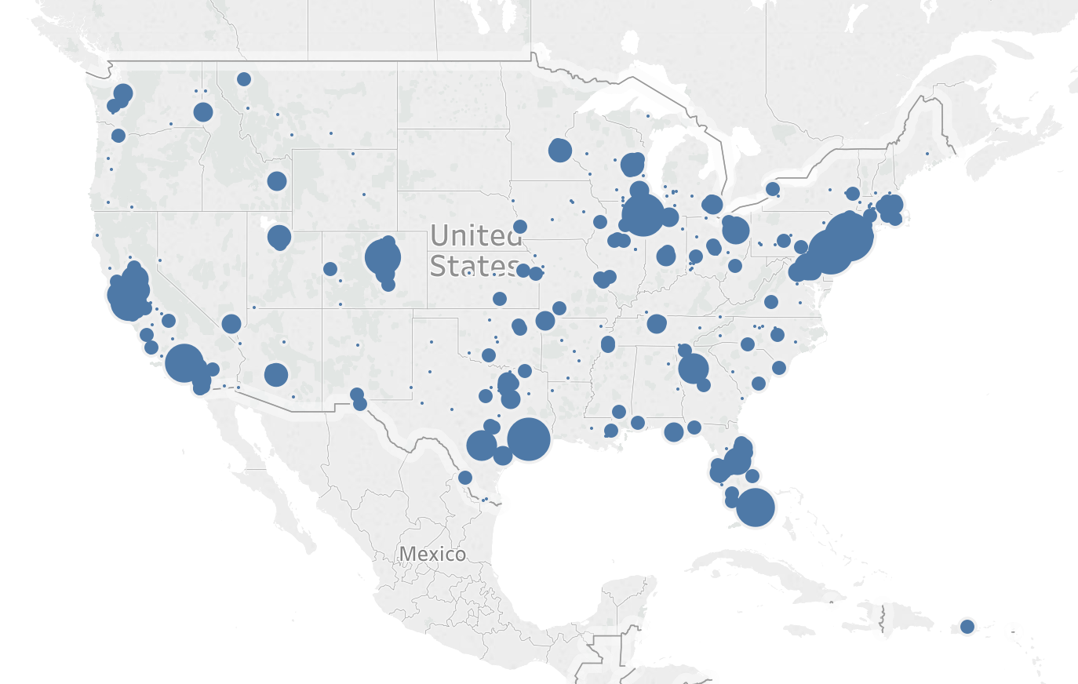
Geography of Mobile Users

Slide 3
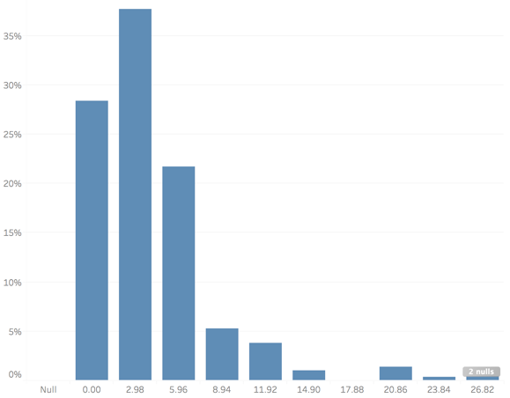
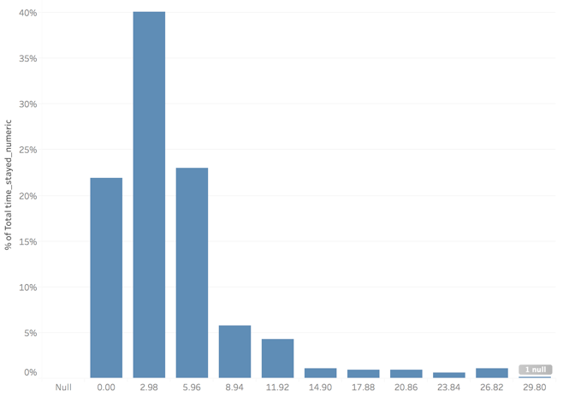
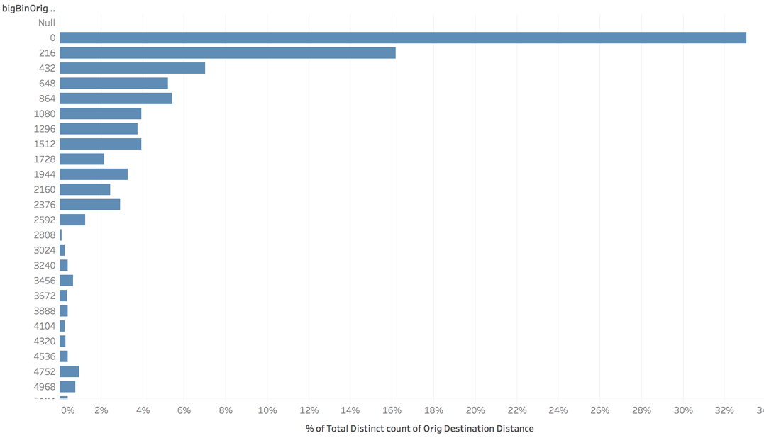
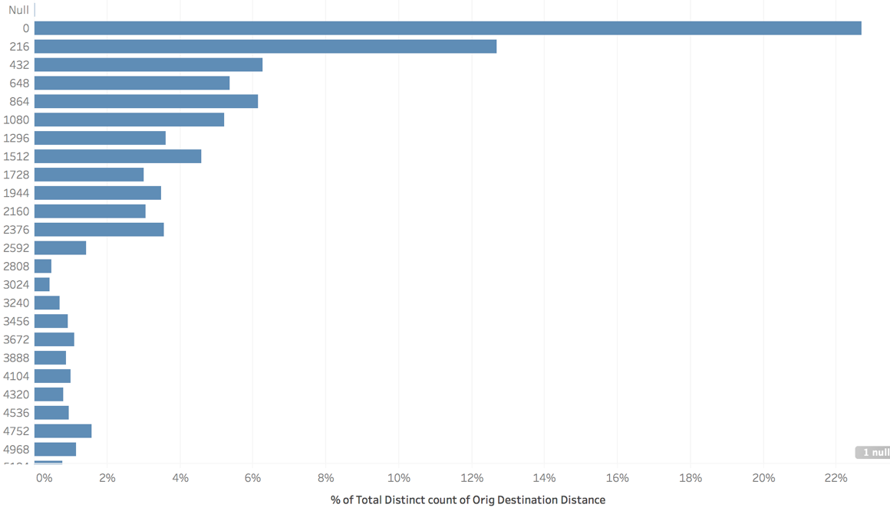
Short-term Bookings
Length of Stay for Mobile Users
Length of Stay for non-Mobile Users
Percentage of Total Distance Traveled for Mobile Users
Percentage of Total Distance Traveled for non-Mobile Users

Slide 4
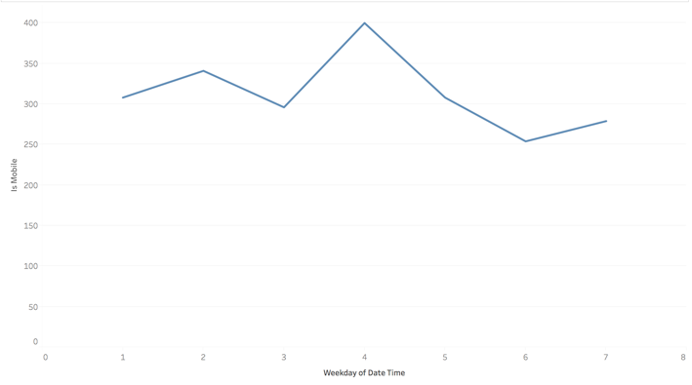
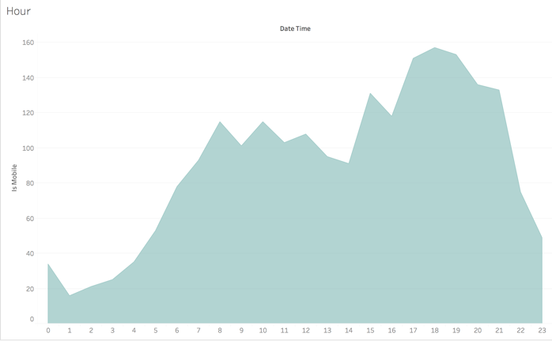
It’s Booking Time!
Booking/clicking time is highest on Wednesdays and lowest on Saturdays.
Booking/clicking time is highest at 7pm.

